Slide 1
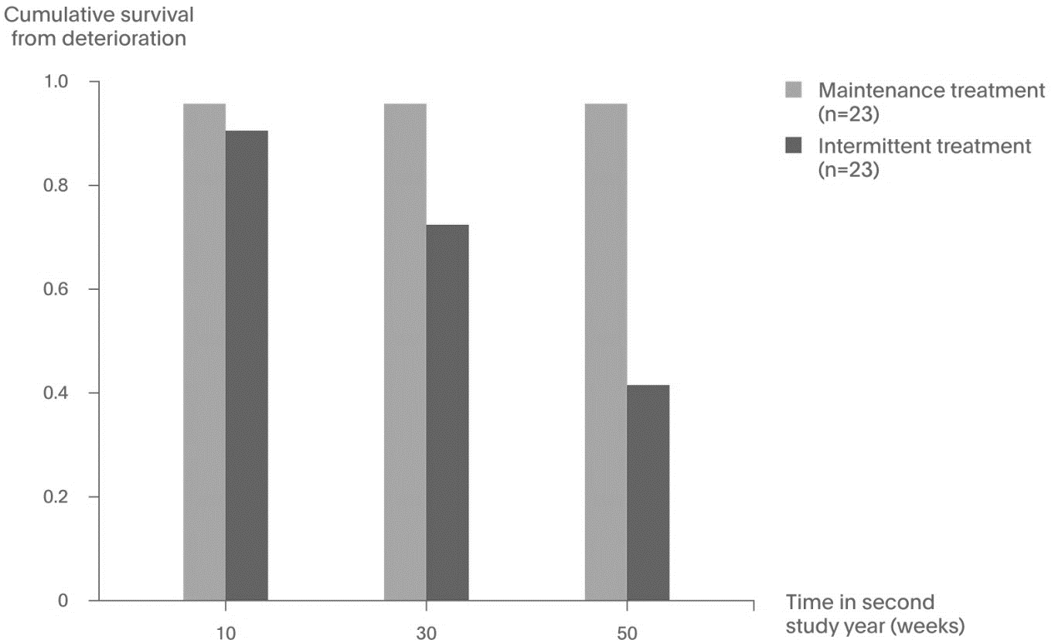
Continuous Maintenance Treatment Led to Decreased Deterioration in Symptoms During the Second Year Following Diagnosis
Schizophrenia
*Increase from baseline in the sum of PANSS™ positive and negative scores ≥25% or ≥10 points (if baseline value ≤40) or a CGI-C score ≥6.
CGI-C = Clinical Global Impression-Change scale; PANSS™ = Positive and Negative Syndrome Scale, a trademark of Multi-Health Systems, Inc.;
Gaebel W, et al. J Clin Psychiatry. 2011;72(2):205-218.
Notes:
This randomized controlled trial investigated the impact of continuous maintenance treatment vs targeted intermittent treatment in the second year following the diagnosis of schizophrenia. A total of 96 first-episode patients were enrolled from the German Research Network on Schizophrenia, and 44 were assigned to treatment. Participants assigned to the maintenance treatment arm in the second year of the trial demonstrated decreased risk of relapse and a higher survival rate from deterioration.
Reference
Gaebel W, Riesbeck M, Wölwer W, et al; for the German Study Group on First-Episode Schizophrenia. Relapse prevention in first-episode schizophrenia—maintenance vs intermittent drug treatment with prodrome-based early intervention: results of a randomized controlled trial within the German Research Network on Schizophrenia. J Clin Psychiatry. 2011;72(2):205-218.

